Slide 1
Score-Based Models
lecture 14
CS236: Deep Generative Models

Slide 2
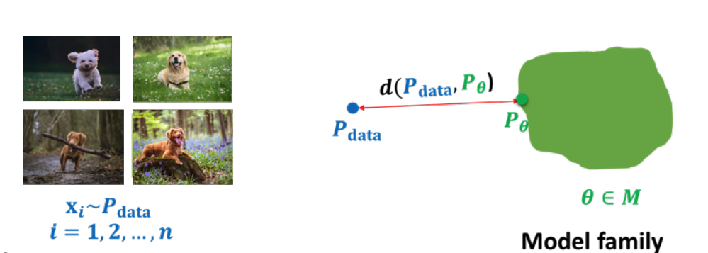
Summary

Slide 3
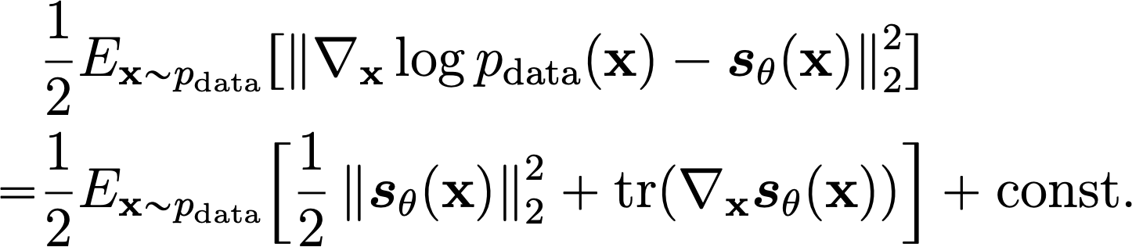
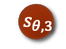
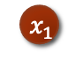
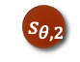
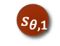
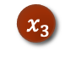
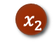
Score-based models
A model that represents the score function
Score estimation: training the score-based model from datapoints
Score matching
Not scalable for deep score-based models and high dimensional data
$${ x}_{1}$$
$${ s}_{θ,1}$$
$${ x}_{2}$$
$${ s}_{θ,2}$$
$$x_{3}$$
$${ s}_{θ,3}$$

Slide 4
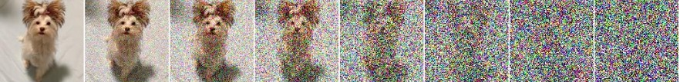
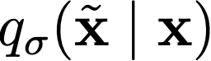
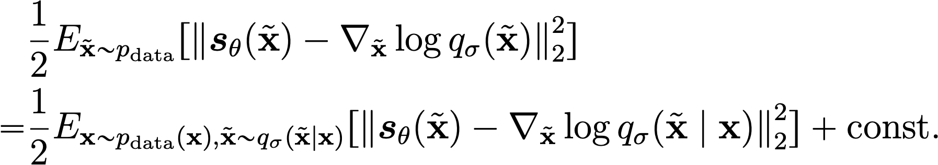
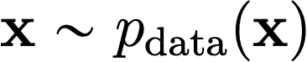
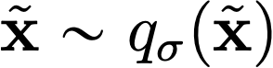
Denoising score matching
Pros:
Much more scalable than score matching
Reduces score estimation to a denoising task
Con: estimates score of noise-perturbed data
Perturbation
distribution/kernel
Data
distribution
Noise-perturbed
data distribution

Slide 5
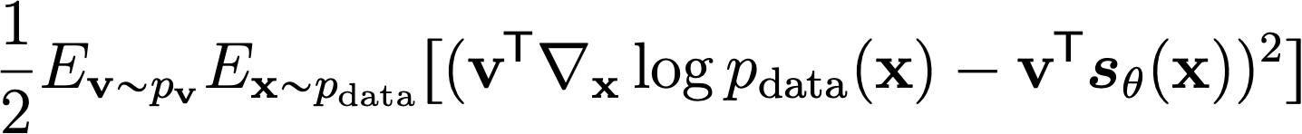
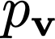
Sliced score matching
Projection distribution can be Gaussian or Rademacher
Pros:
Much more scalable than score matching;
Estimates the true data score.
Con: Slower than denoising score matching.

Slide 6

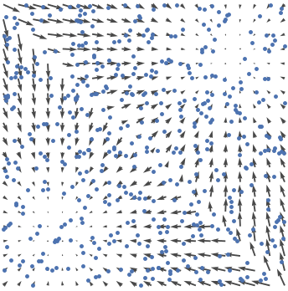
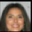
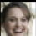
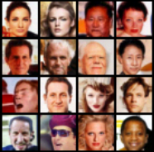




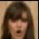


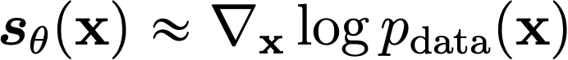
Score-based generative modeling
score
matching
Langevin
dynamics
Data samples
Scores
New samples
Notes:
So far, I have discussed how to estimate scores efficiently from iid samples of a distribution. We can have a score model, and then train it with some efficient variant of score matching to approximate the score of p.
Next, I will show how to build a generative model using the estimated score. This requires us to sample from the score model efficiently.

Slide 7
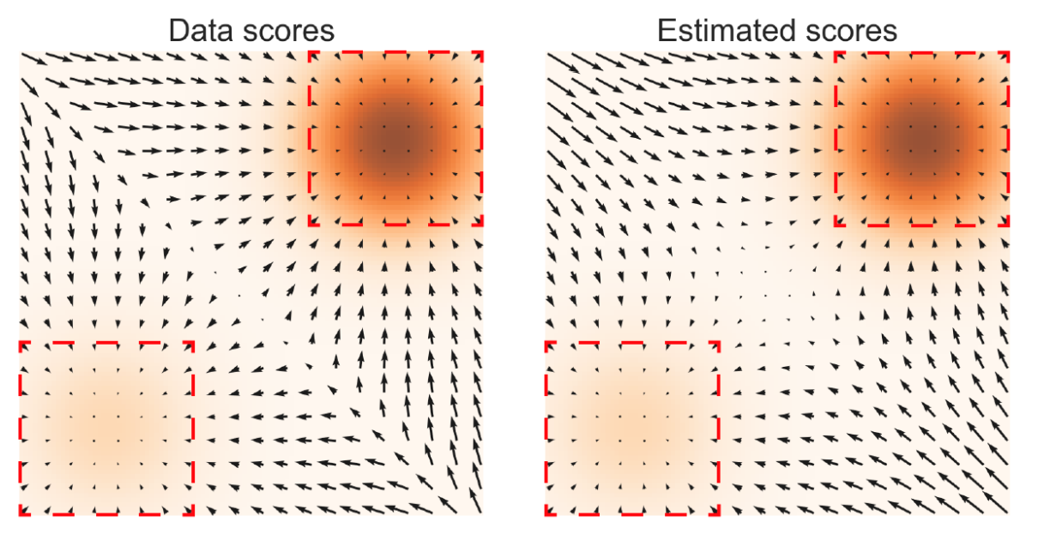
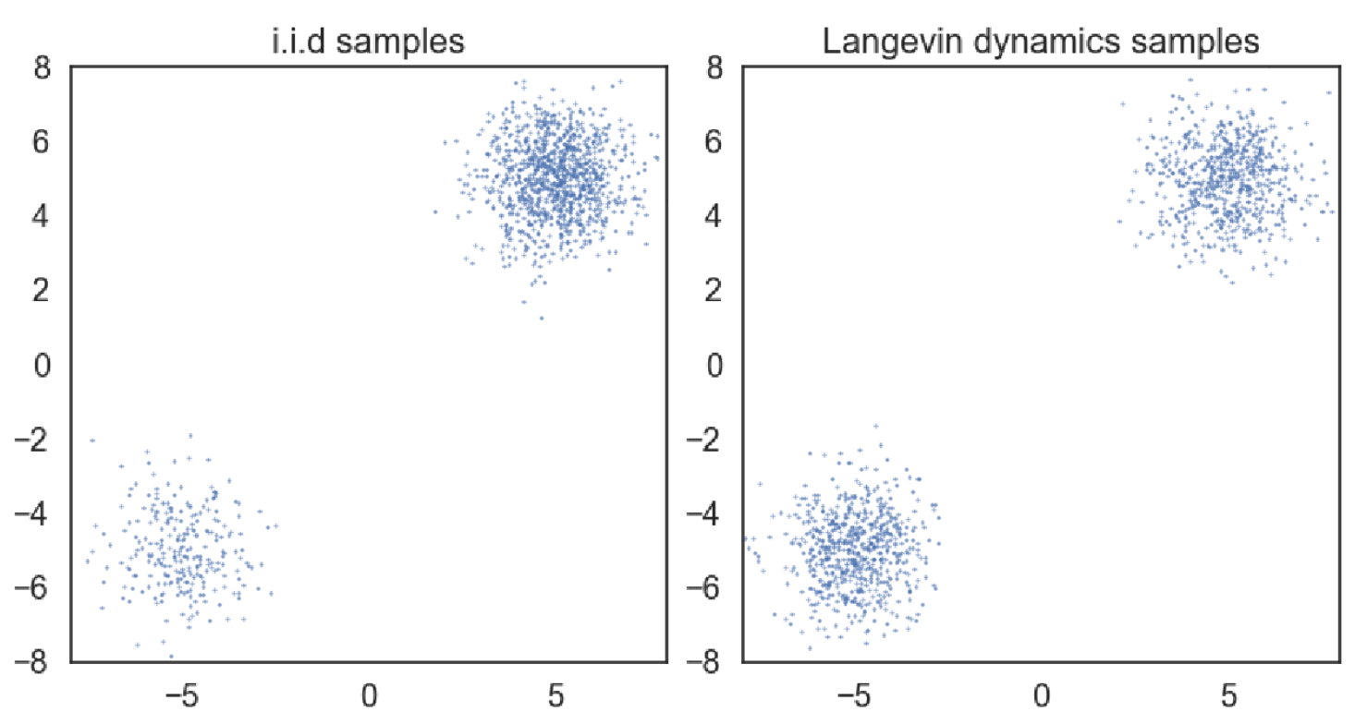
Pitfalls
Manifold hypothesis. Data score is undefined.
Score matching fails in low data density regions
Langevin dynamics converges very slowly
Data points
Notes:
Unfortunately, score-based generative modeling does not work out of the box. We identify several pitfalls that pinpoint the reasons that it does not work well in practice.
The first pitfall is the manifold hypothesis. The manifold hypothesis states that in real world, data points lie in low-dimensional spaces with a much smaller dimension than the data dimension. For example, data points might lie on a two dimensional mobius strip, even though the data dimension is 3.
The score of data distribution is undefined when data are constrained to a low dimensional manifold. Intuitively, suppose the data distribution is concentrated around a ring. When the ring becomes thinner and thinner, the score vectors will also become larger and larger. In the limit that the ring becomes infinitely thin, the score vectors will also become infinitely large. This makes score vectors undefined on a low-dimensional manifold structure.

Slide 8
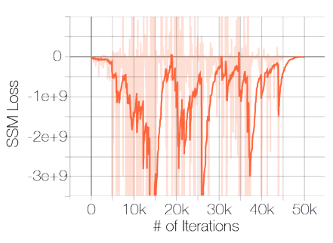
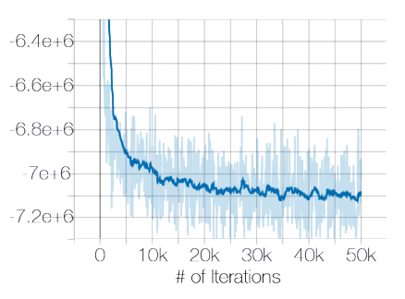
Gaussian perturbation
The solution to all pitfalls: Gaussian perturbation!
Manifold + noise
Score matching on noisy data.
CIFAR-10
Noisy CIFAR-10
Notes:
How can we combat these pitfalls? We propose to perturb the data with Gaussian noise. First, it solves the problem of manifold hypothesis, because Gaussian noise has support all over the space. Recall that when no noise was added, the learning curve of score estimation diverges. When we add a tiny amount of Gaussian noise to the data, the curve converges nicely. Note that the Gaussian noise has a variance of 0.0001, which leaves the perturbed image indistinguishable to humans when the pixel values are in [0,1].

Slide 9
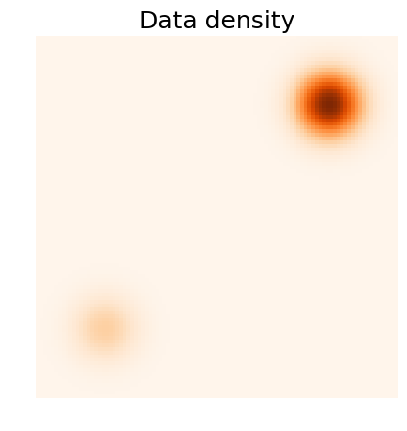
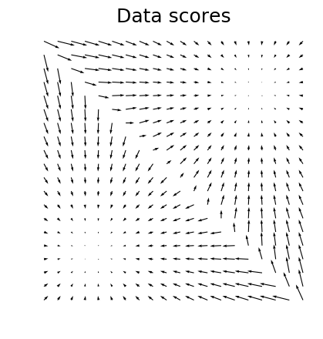
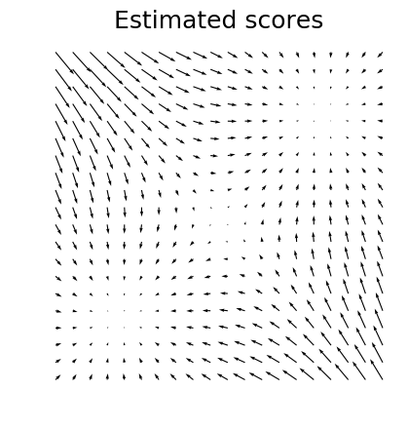
Challenge in low data density regions
Accurate
Accurate
Inaccurate
Inaccurate
Accurate
Accurate
Song and Ermon. “Generative Modeling by Estimating Gradients of the Data Distribution.” NeurIPS 2019.
Notes:
However, the naïve score matching plus Langevin MCMC does not work well in practice because score estimation is inaccurate in low data density regions.
To illustrate this fact, let’s consider a mixture of Gaussian distribution. The left figure is the data density. The middle figure shows ground-truth data scores, while the right figure shows estimated scores.
Comparing middle and right figures, score estimation is only accurate in the highlighted regions, which are those of high data density. For low-data density regions between the two modes, the score estimation is vastly inaccurate.
Why can this happen? This is because the score matching objective only considers the difference between data and model scores at data samples.
But in regions of low data density where almost no data samples are provided, there is not enough information to infer the correct scores from samples.
This challenge prevents Langevin MCMC from exploring low density regions properly using the learned score model. And it won’t produce good samples when the initialization is bad.

Slide 10
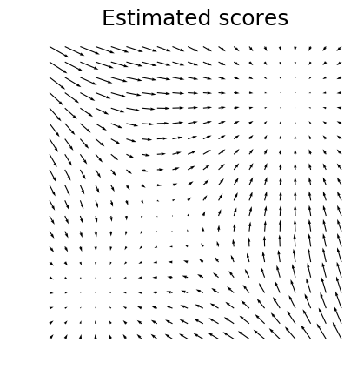
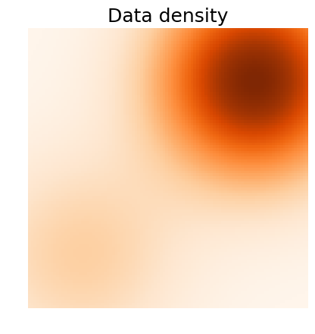
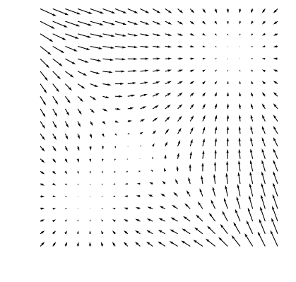


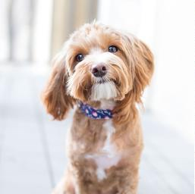
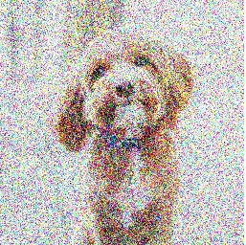
Improving score estimation by adding noise
High noise provides useful directional information for Langevin dynamics.
Accurate
Accurate
But perturbed density no longer approximates the true data density.

Slide 11
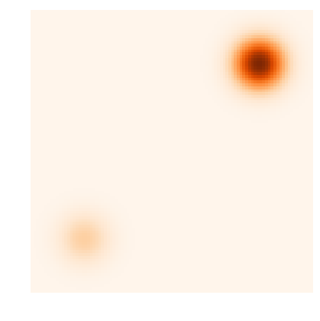
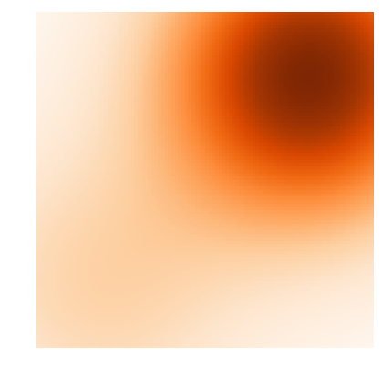
Multi-scale Noise Perturbation
How much noise to add?
Multi-scale noise perturbations.
…
Notes:
There is a trade-off between data quality and the size of low data-density regions. On the one side of the spectrum, we add very small amount of noise so that the perturbed data are close to the original data, but the low data density regions can be large. On the other side of the spectrum, we add large amount of noise to keep the low data density regions small, but this also destroys the original data.
To mediate the two sides of the spectrum, we propose to perturb data with different levels of noise simulteanously, and aggregate the information from all noise levels.

Slide 12
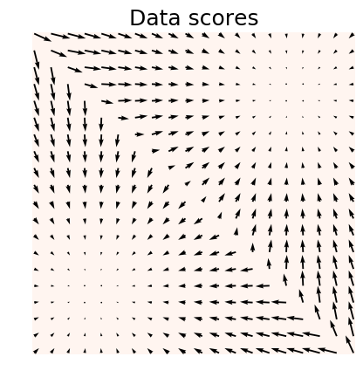
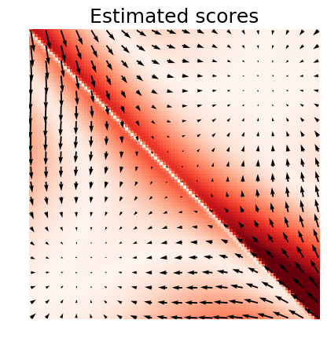
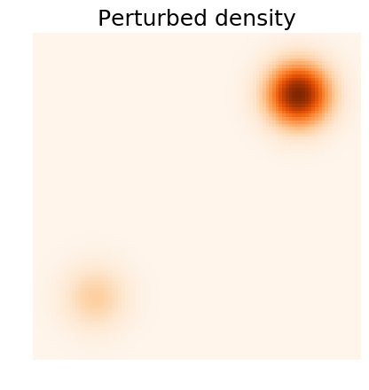
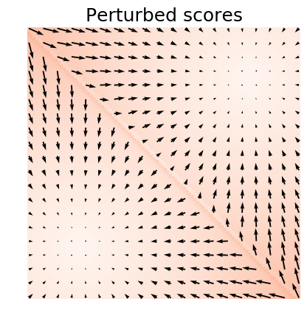
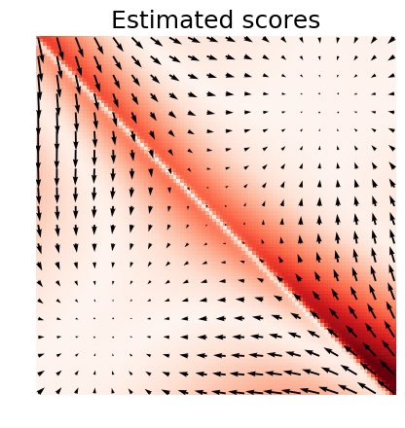
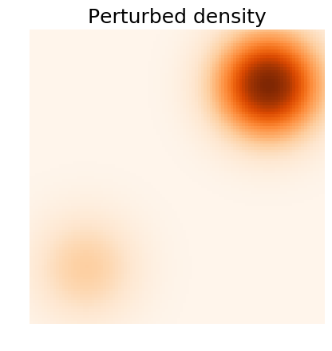
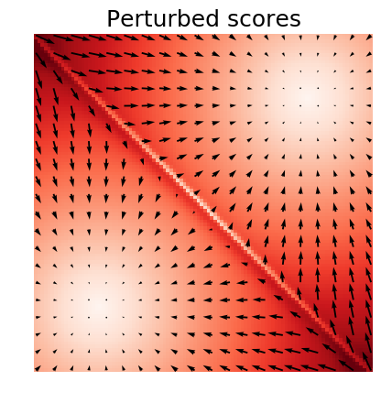
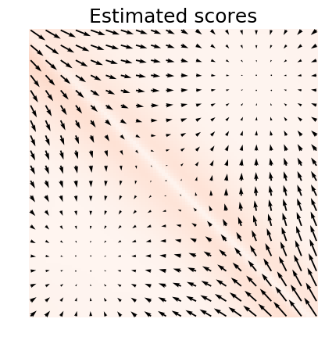
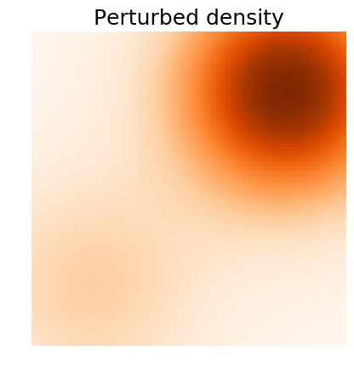
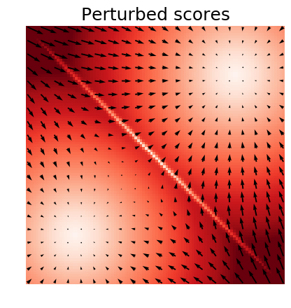
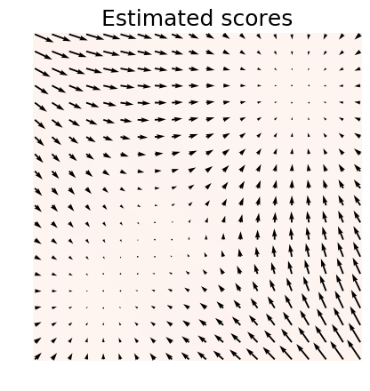
Trading off Data Quality and Estimation Accuracy
(Red encodes error)
Worse data quality!
Better score estimation!
Notes:
There is a trade-off between data quality and the accuracy of score estimation when considering how much noise we should add.
Let's return to the mixture of Gaussian distribution. When no noise is added, the ground-truth data score is not affected, but the estimated scores are inaccurate in low data density regions. Here red color in the rightmost figure is to code estimation errors.
Now consider perturbing the data with small noise. The red color in the middle figure codes the difference between the perturbed data score and the orignal data score.
When the noise is small, the perturbed distribution is close to the original distribution, but the estimation errors are still high
When we add larger and larger noise, the estimation error becomes smaller and smaller, but the perturbed data score differs from the original data score by a lot.
In order to achieve the best data quality and estimation accuracy at the same time, we should consider all perturbations jointly instead of focusing on only one perturbation.

Slide 13
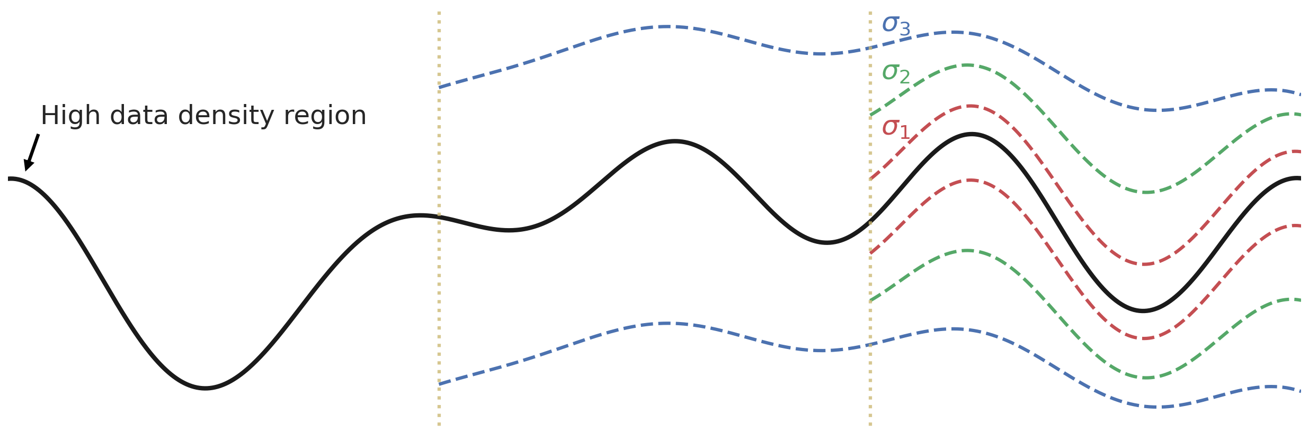

Using multiple noise scales
Notes:
In practice, we might want to use multiple scales of noise to perturb the data distribution, and estimate the score of each noise-perturbed distribution.
Here is the intuition. Without noise perturbation, the estimated scores in low data density regions can be vastly inaccurate, and there will be no information on how to get to high data density regions for Langevin dynamics.
Alternatively, we might use one single noise scale to perturb the data distribution. To cover large portion of the low data density region, this noise scale has to be large. It gives directional information when Langevin dynamics is far away from high data density regions, but may fail to provide fine-grained directional information when Langevin dynamics is close to high data density regions.
This problem can be solved by using multiple noise scales. The scores of noise perturbed distributions with multiple scales can provide directional information of multiple granularity, and give useful guidance in various distances from the high data density region.

Slide 14
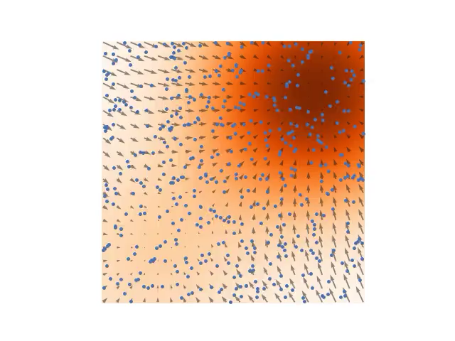
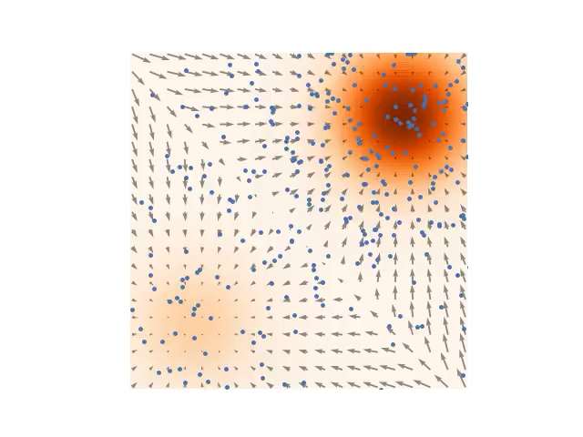
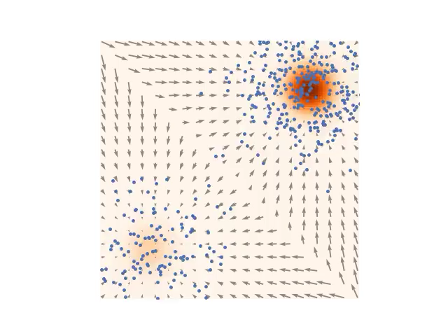





Annealed Langevin Dynamics: Joint Scores to Samples
Sample using sequentially with Langevin dynamics.
Anneal down the noise level.
Samples used as initialization for the next level.
Notes:
How can we sample from the noise conditional score network using scores of different noise levels?
Our method is called annealed Langevin dynamics. We do langevin dynamics for different levels of perturbed data distribution sequentially. We first use Langevin dynamics to sample from the most perturbed data distribution. Then, the resulting samples will be used as initial samples for sampling from the next noise level. We continue in this fashion, and finally use Langevin dynamics to sample from the least perturbed data distribution.
(fix the animation bug)

Slide 15

Annealed Langevin dynamics

Slide 16



Comparison to the vanilla Langevin dynamics
Langevin dynamics
Annealed Langevin dynamics
Notes:
Annealed Langevin dynamics effectively mitigate the inaccurate estimation of relative weights of different modes. To show this, we conduct Langevin dynamics and annealed Langevin dynamics on the same mixture of Gaussian distribution we used before. Here are the results.
The results from annealed Langevin dynamics is very close to the exact samples, and correctly recovers the relative weights between modes. While Langevin dynamics fail to do so.

Slide 17





Joint Score Estimation via Noise Conditional Score Networks
$${ x}_{1}$$
$${ s}_{θ,1}$$
$${ x}_{2}$$
$$σ$$
$${ s}_{θ,2}$$
Noise Conditional Score Network
(NCSN)
Notes:
More specifically, for each perturbed data distribution, we can easily sample from them, and use score estimation to estimate the corresponding scores.
However, the most naïve way of doing this requires a large number of separate score models to be learned independently, which is very costly.
We propose instead to use a single conditional score network to estimate the scores jointly for all perturbation levels. The score model will take sigma as an input. This model is named the Noise Conditional Score Network.

Slide 18


Training noise conditional score networks
Which score matching loss?
Sliced score matching?
Denoising score matching?
Denoising score matching is naturally suitable, since the goal is to estimate the score of perturbed data distributions.
Weighted combination of denoising score matching losses

Slide 19


Choosing noise scales
Maximum noise scale
Minimum noise scale: should be sufficiently small so that noise in final samples is negligible.
Notes:
In this work, we propose several techniques to make training and tuning of score-based models easier.
Our first technique is on how to choose the largest noise scale. We recommend making the scale comparable to the maximum pairwise distance for training data.
In this case, a Langevin chain can easily transfer from one data point to another
And vice versa.
This makes samples cover more modes and more diverse.

Slide 20


Choosing noise scales
Key intuition: adjacent noise scales should have sufficient overlap to facilitate transitioning across noise scales in annealed Langevin dynamics.
A geometric progression with sufficient length.
Notes:
Our second technique focuses on determining the rest of noise scales. We claim the noise scales should form a geometric sequence, and should be dense enough to make sure adjacent noise scales are sufficiently close to each other.
For example, the first and second noise should have large overlap.
The second and third noise scales should have the same amount of overlap, and so on

Slide 21





Choosing the weighting function
Weighted combination of denoising score matching losses
How to choose the weighting function ?
Goal: balancing different score matching losses in the sum →

Slide 22


Training noise conditional score networks
Sample a mini-batch of datapoints
Sample a mini-batch of noise scale indices
Sample a mini-batch of Gaussian noise
Estimate the weighted mixture of score matching losses
Stochastic gradient descent
As efficient as training one single non-conditional score-based model

Slide 23











Using multiple noise levels
Data
Positive weighting
function
Annealed Langevin dynamics
Noise Conditional
Score Model
Score matching loss

Slide 24

Experiments: Sampling
Notes:
The following demonstrates the sampling procedure of annealed Langevin dynamics using estimated scores on several image datasets. It is pretty amazing that we can start from random noise, modify the images according to scores, and generate nice looking images.

Slide 25

Experiments: sampling

Slide 26

High Resolution Image Generation
Notes:
Below are samples on various image datasets with various resolutions, all trained and sampled according to our techniques.

Slide 27







Infinite noise levels

Slide 28








Perturbing data with stochastic processes
Stochastic process
Stochastic differential equation (SDE)
Deterministic drift
Infinitesimal noise
Probability densities
WLOG: Toy SDE

Slide 29



Generation via reverse stochastic processes
Forward SDE (t: 0→T)
Infinitesimal noise in the reverse time direction
Reverse SDE (t: T→0)
Score function!

Slide 30


Score-based generative modeling via SDEs
Time-dependent score-based model
Training:
Reverse-time SDE
Euler-Maruyama (analgous to Euler for ODEs)
Song, Sohl-Dickstein, Kingma, Kumar, Ermon, Poole. “Score-Based Generative Modeling through Stochastic Differential Equations.” ICLR 2021.
Notes:
Therefore, we can generate samples by solving the reverse-time SDE to simulate the reverse-time stochastic process.
One numerical solver for SDEs is the Euler-Maruyama method. It is based on the same idea as Euler’s method for solving ODEs. Basically, we replace the infinitesimal time step dt with a small time difference Delta t, and we replace the infinitesimal white noise with a Gaussian noise with variance Delta t. Here Delta t is a negative time step, and t goes from T to 0.
We can train a time-dependent score-based model to approximate the score function as a function of time. This time-dependent score-based model is a neural network conditioned on time t, and can be trained by first randomly sampling t, and then minimizing the corresponding score matching loss.

Slide 31
Predictor-Corrector sampling methods
Predictor-Corrector sampling.
Predictor: Numerical SDE solver
Corrector: Score-based MCMC
corrector
predictor
Notes:
We can apply any other general-purpose SDE solver for sampling. Besides, knowing the score function allows new SDE solvers and hence new samplers. The first method we consider is one family of methods named predictor-corrector samplers. As the name suggests, the method consists of a predictor and a corrector. The predictor can be a general-purpose SDE solver like the Euler-Maruyama method, and the corrector can be any score-based MCMC approach such as Langevin dynamics.
So how does the method work? When solving the reverse-time SDE, we first use the predictor to get a rough estimate of the intermediate sample at the next time step, and then use the corrector to fine-tune the sample. This procedure is repeated multiple times until we finally get a sample from the original unperturbed data distribution.
Predictor-Corrector methods assembles annealed Langevin dynamics. However, the introduction of the predictor helps Langevin dynamics to make a smooth transition between different noise scales.

Slide 32

Results on predictor-corrector sampling
Song, Sohl-Dickstein, Kingma, Kumar, Ermon, Poole. “Score-Based Generative Modeling through Stochastic Differential Equations.” ICLR 2021.
Notes:
With predictor-corrector samplers and some architectural improvements, we were able to set the new record of sample generation on CIFAR-10. Our results are highlighted with the green box. There are several configurations of our NCSN++ model which I won’t be able to cover in this talk. Our best model achieves an FID of 2.2, and inception score of 9.89. The previous best result was achieved by StyleGAN2 plus data augmentation, yet we were able to surpass their result even without data augmentation. Moreover, our FID score on unconditional generation is even better than the state-of-the-art on conditional generation. This is a really exciting breakthrough.

Slide 33


High-Fidelity Generation for 1024x1024 Images
Notes:
With predictor-corrector samplers and new progressive growing architectures, we were able to produce the first set of high resolution facial samples from score-based models. All the samples here have a resolution of 1024x1024.

Slide 34





Converting the SDE to an ODE
SDE
Ordinary differential equation (ODE)
Score function

Slide 35






Evaluating the probabilities with ODEs
→ ODE
Computing the probability density function (change of variables formula)
Computable in polynomial time
Unbiased
estimator
ODE solver
It is a (continuous-time) normalizing flow model!

Slide 36
Achieving highest probabilities on test data
Negative log-probability ↓
(bits/dim)
Method | CIFAR-10 | ImageNet 32x32
PixelSNAIL [Chen et al. 2018] | 2.85 | 3.80
Delta-VAE [Razavi et al. 2019] | 2.83 | 3.77
Sparse Transformer [Child et al. 2019] | 2.80 | –
Score flow model | 2.83 | 3.76
Challenges years of dominance of autoregressive models and VAEs

Slide 37
Accelerated sampling
→ ODE
Numerical methods + ODE formulation to accelerate sampling
DDIM [Song and Ermon, 2021]:
Coarsely discretize the time axis, take big steps
Corresponds to exponential integrator (semi-linear ODE) [Lu et al, 2022; Zhang and Chen, 2022]
10x-50x speedups, comparable sample quality

Slide 38













Control the generation process
Bayes’ rule:
Bayes’ rule for score functions:
Forward model
Control signal
= “dog”
0
Plug in different forward models for the same score model
Unconditional score
Forward model
Inverse distribution

Slide 39


Stroke to image synthesis
Forward model
can be specified.
Stroke paintings
Sampled images
[Meng, He, Song, Song, Wu, Zhu, Ermon. ICLR 2022]

Slide 40





Language-guided image generation
(Prompt)
Treehouse in the style of Studio Ghibli animation
Forward model
is an image captioning neural network.
[ Work by @danielrussruss ]

Slide 41


Controllable generation: Text-guided generation
An abstract painting of computer science:
A painting of the starry night by van Gogh
https://colab.research.google.com/drive/1FuOobQOmDJuG7rGsMWfQa883A9r4HxEO?usp=sharing

Slide 42
Conclusion
Gradients of distributions (scores) can be estimated easily
Flexible architecture choices — no need to be normalized/invertible
Stable training — no minimax optimization
Better or comparable sample quality to GANs
State-of-the-art performance on CIFAR-10 and others
Scalable to resolution of 1024x1024 for image generation
Exact likelihood computation
State-of-the-art likelihood on CIFAR-10
Sample editing via manuplating latent codes
Notes:
In conclusion, we introduced score-based generative modeling. There are several take-aways.
First, score functions, which are gradients of distributions can be estimated easily.
We can choose flexible architectures for the score-based model, no need of being normalized or invertible.
The training is stable, and there is no need of minimax optimization or adversarial training.
Second, score-based generative models typically achieve very high sample quality comparable or surpassing GANs.
It is currently the state-of-the-art method on CIFAR-10 and some other datasets.
It is scalable to images with resolution as large as 1024 by 1024.
Finally, you can compute the exact likelihood of score-based models.
The likelihood obtained on CIFAR-10 is very competitive, being the state-of-the-art evaluated on uniformly dequantized data.
The equivalence to neural ODE allows many other things that flow models are good at, such as interpolation and temperature scaling. In addition, our encoding is uniquely identifiable.

